Slide 1




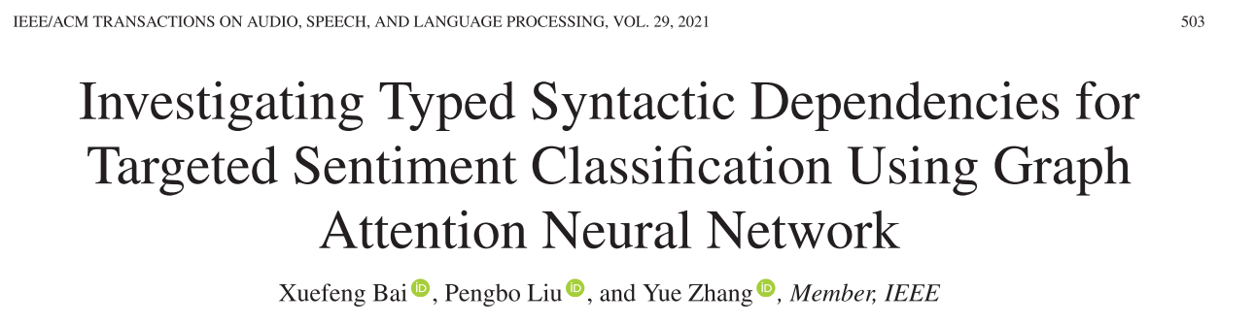





Chongqing University of Technology
ATAI
Advanced Technique of Artificial Intelligence
Chongqing University of Technology
TASLP_2021
https://github.com/muyeby/RGAT-ABSA
Hongyang Song

Slide 2
Outline
Motivation
Approach
Experiments
Conclusion

Slide 3
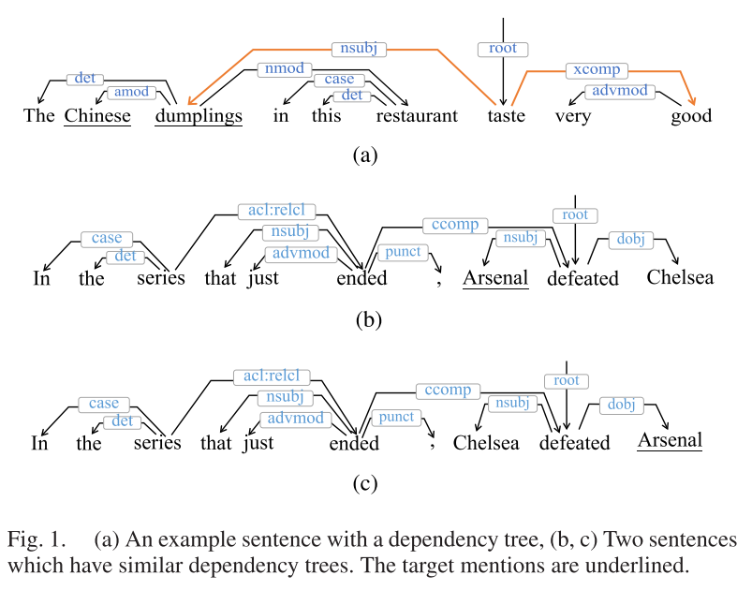
Motivation

Slide 4
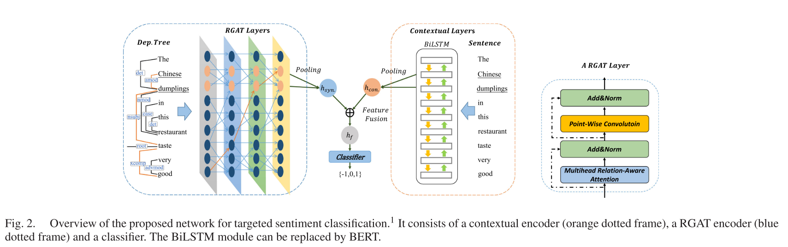
Approach
Notes:
recent channels impressions: 展示给用户的渠道 impression indicates the item/channel is exposed/shown to a user

Slide 5
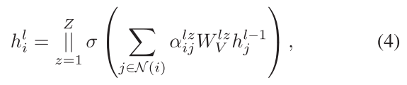
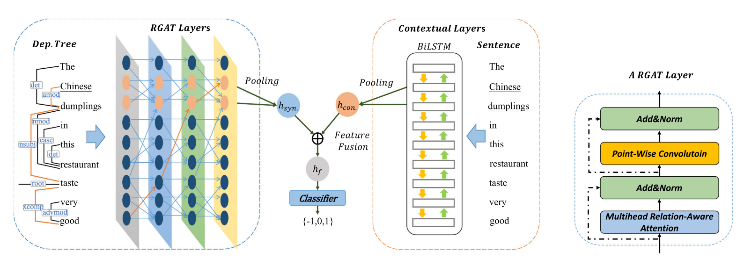
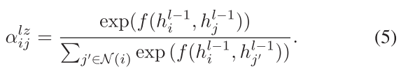

Approach
Notes:
recent channels impressions: 展示给用户的渠道 impression indicates the item/channel is exposed/shown to a user

Slide 6
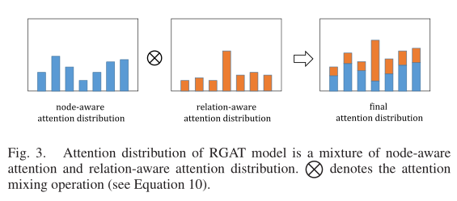








Approach
Fig.
Notes:
recent channels impressions: 展示给用户的渠道 impression indicates the item/channel is exposed/shown to a user

Slide 7
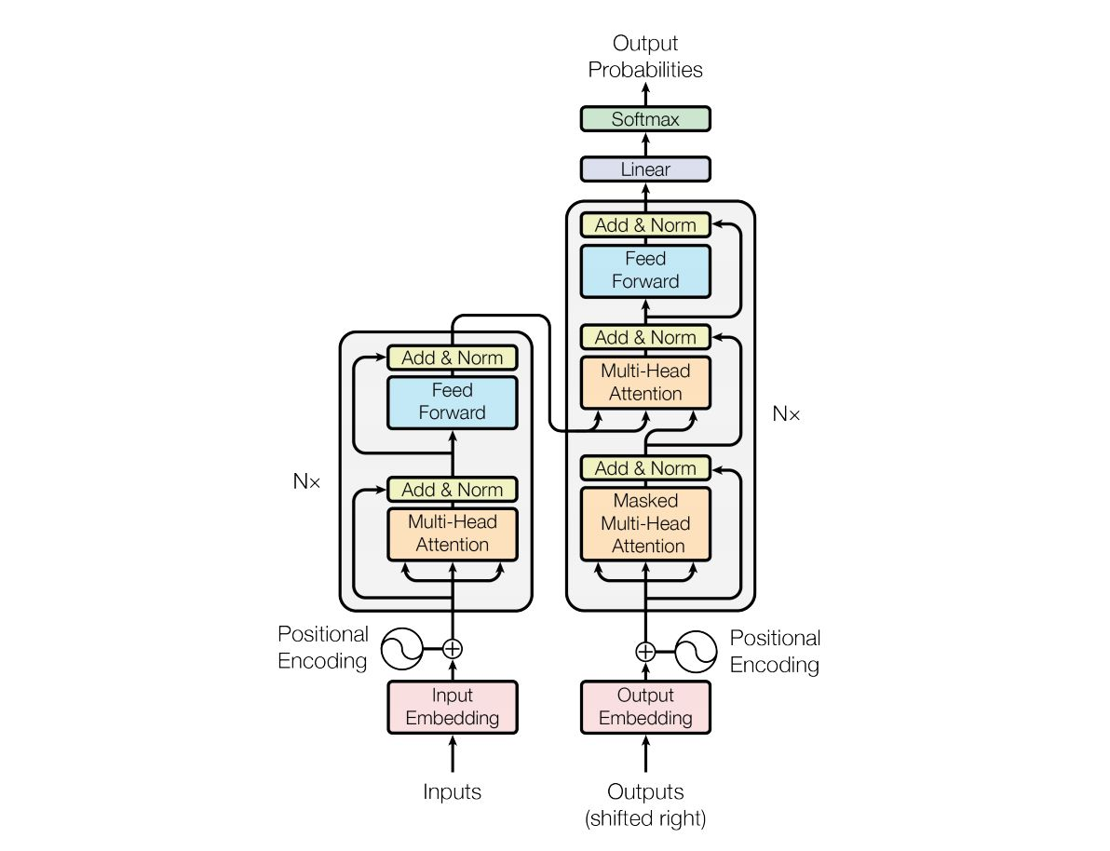
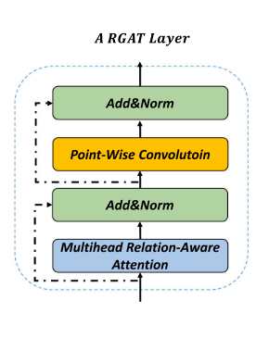

Slide 8
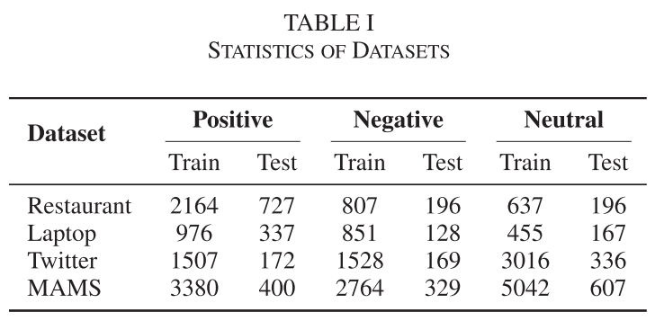
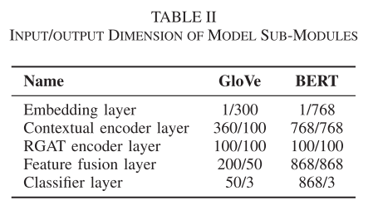
Experiments

Slide 9
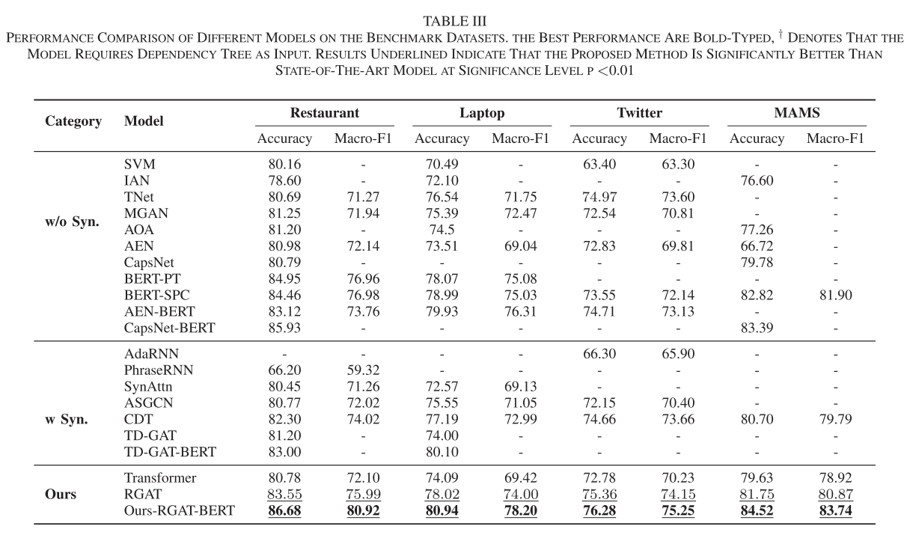
Experiments

Slide 10
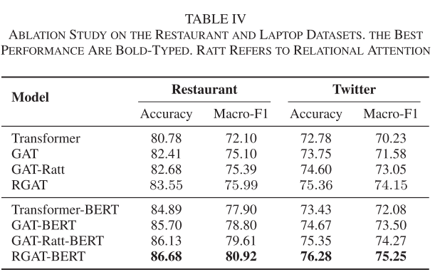
Experiments

Slide 11
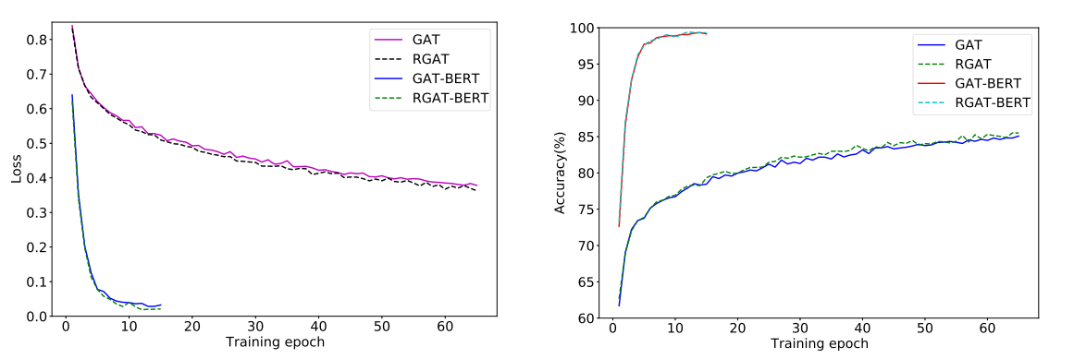
Experiments

Slide 12
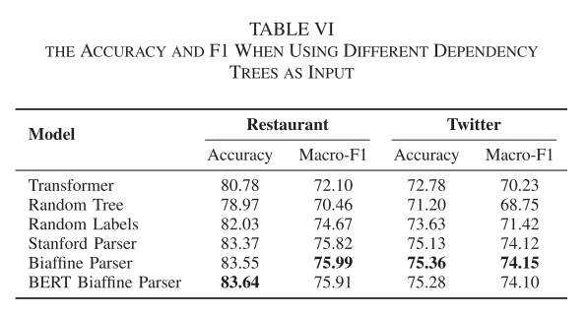
Experiments

Slide 13
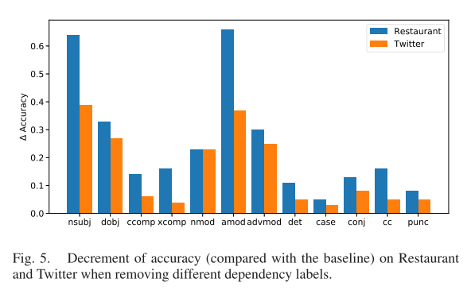
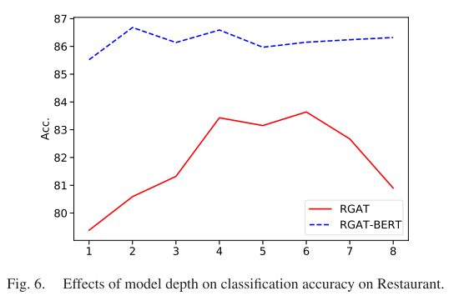
Experiments

Slide 14
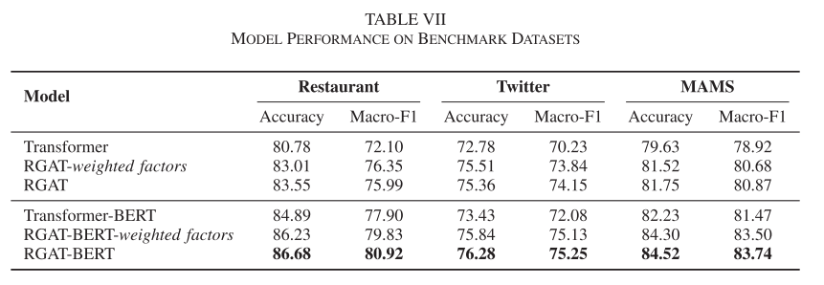
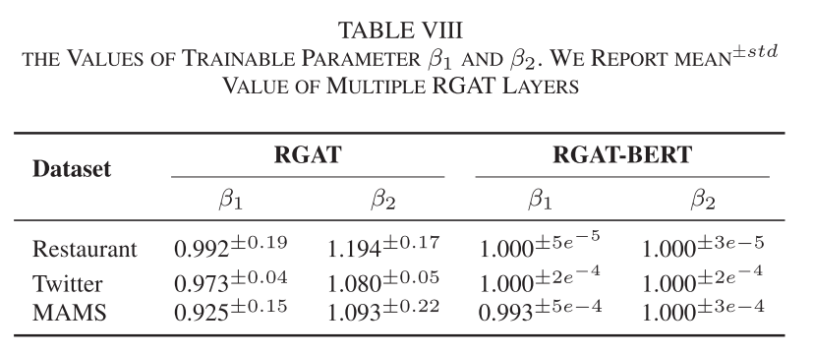
Experiments

Slide 15
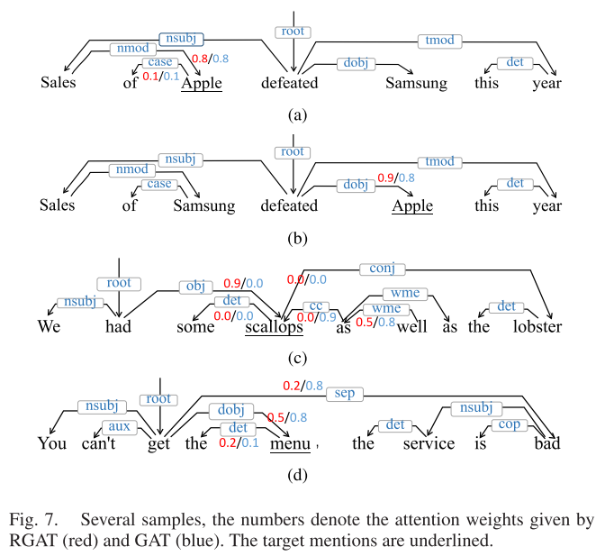
Experiments

Slide 16
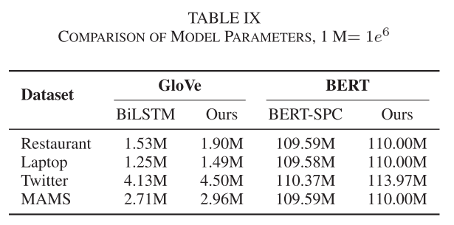
Experiments

Slide 17
Thanks

